Slide 1
Anderson Parent Night
Anderson Parent Night – Th. Feb. 9th - 6 PM-8 PM, Anderson Fine Arts Wing
 | Cafeteria | Orchestra | Room 20 | Room 21 | Choir | Theatre
6:00 | Transitioning to High School (8th Grade Parents) | Picking the Right Level of Courses: Students' perspective | High School Programs to Earn College Credit | Assisting Your Child's Social and Emotional Well-Being
6:30 |  | Picking the Right Level of Courses: Students' perspective | High School Programs to Earn College Credit | Assisting Your Child's Social and Emotional Well-Being | Ask a Counselor: Bring your Course Selection Questions
7:00 |  | Picking the Right Level of Courses: Students' perspective |  |  | Ask a Counselor: Bring your Course Selection Questions | Signs and Symptoms of Drug Abuse
7:30 |  |  |  |  | Ask a Counselor: Bring your Course Selection Questions

Slide 2

8th grade parent night
Anderson High School
Presented by Geoff Harter

Slide 3

Course Advisement Online Resources

Slide 4
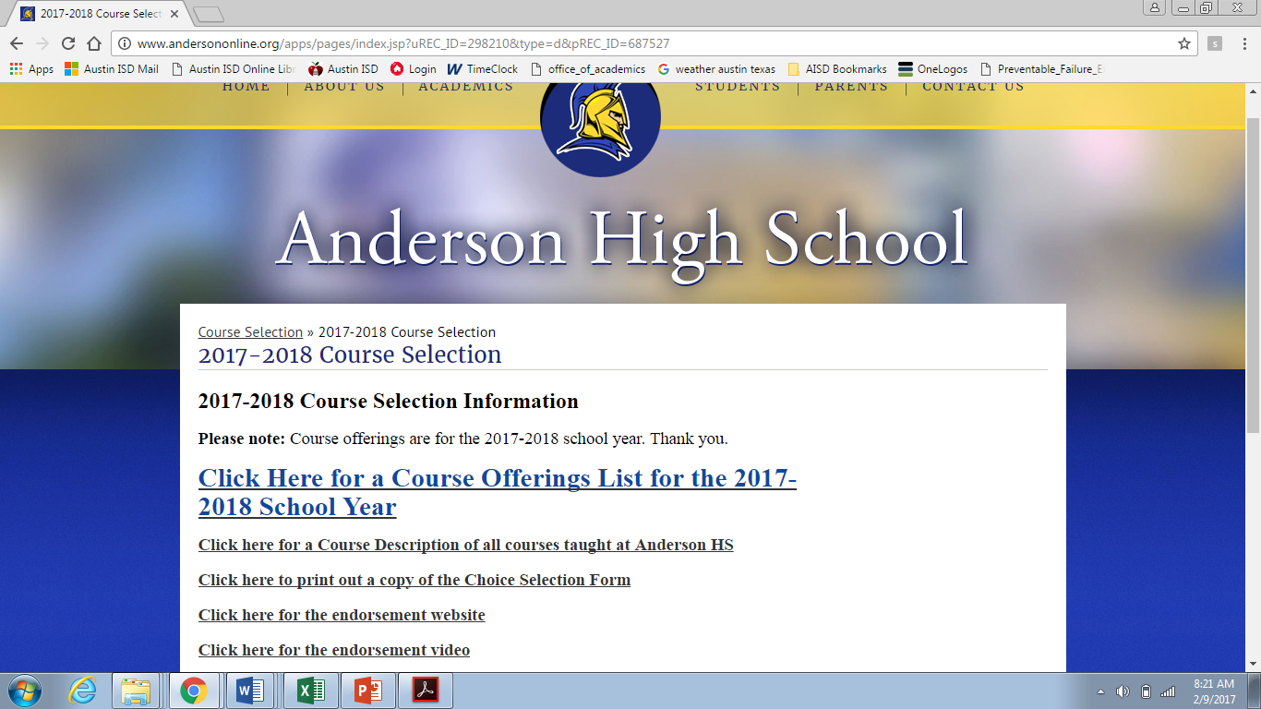
Anderson Course Advisement webpages

Slide 5
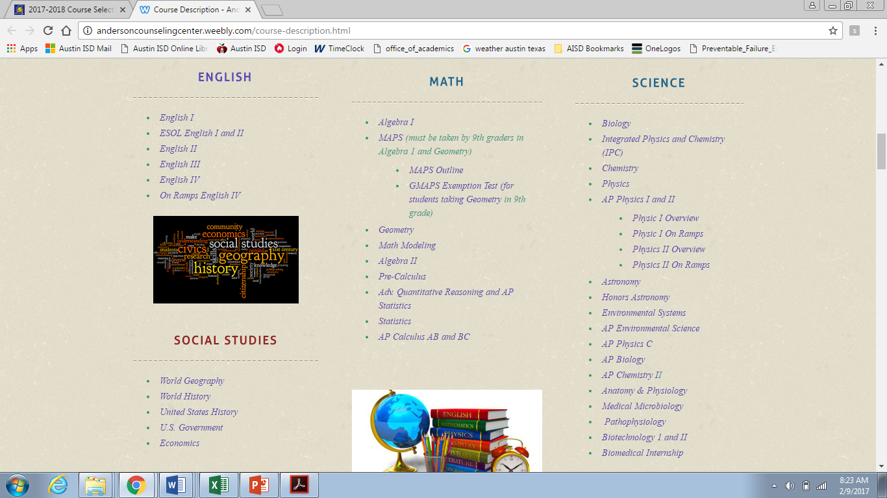

Slide 6
Anderson Course Selection Sheet
______________________________
Course Changes to this section must be
Student may
make
th
th
th
changes to 10
, 11
, and 12
grade courses in four
-
ye
ar
plan at any time
. For more
requested by August 1, 2017
information visit the AISD Website:
.
Graduation
www.austinisd.org/graduationplans
Requirements
9
th
Grade Courses
MS Teacher
th
th
th
Write in course selection for 2016
10
Grade Courses
11
Grade Courses
12
Grade Courses
-
2017 school year. If
Signature
you select a Pre
-
AP Course, a Middle School teacher’s
Approval
signature is required.
English (4 credits)
1
1
1
1
Math (4)
2
2
2
2
Science (4)
3
3
3
3
Social Studies (4)
4
4
4
4
M
th
LOTE (2 )
5
APS (Required for 9
Grade)
5
5
5
Fine Arts (1)
6
6
6
6
P.E. (1)
7
7
7
7
Health (0.5)
8
8
8
8
Electives (5.5)
th
Courses in 0 and 9
0
0
0
0
Hour are classes before
9
9
9
9
(0) and after (9) school.
Three Alternative Courses:
Choice 1: ___________________________ Choice 2: _______
____________________ Choice 3: ____________________________

Slide 7
Graduation Requirements
All students of the Class of 2020 are on the Distinguished Level of Achievement with Endorsements Plan (see handout)
4 X 4 Required Courses
  English
  Math
  Science
  Social Studies (graduation
  plan only requires 3, but
  colleges want 4 credits)

Slide 8
Distinguished Level of Achievement
Plan Requirements
4 English Courses
  English 1, English 2, English 3, and English 4
4 Social Studies Courses
  W. Geography, W. History, US History, and Government/Economics (Gov/Eco are each one semester during senior year)
4 Math Courses
  Alg. 1, Geometry, Alg. 2 & a 4th Math Course
4 Science Courses
  Biology
  Must take at least one of the following
    IPC, Chemistry, or Physics
  Two more science credits which may include Physics & Chemistry

Slide 9
World Language Requirement
2 years of the same Language other than English
  Credit by exam option for those who are native speakers
Reasons to take more than 2 credits of World Language
  Advantages in workforce/travel if bilingual
  College implications
    Some private, selective admission colleges prefer three years of a language
    Year four of a language is college level so students can test out (AP or IB) of a language and thus earn college credit
  IB Diploma program requires that all students be in a language course in junior year (must be in either year four or five of the language for IB test)
  GPA advantage since year three, four, five, and six are weighted GPA
    More info to come later in presentation about GPA’s in High School

Slide 10
Other Graduation credit requirements
1.0 credit (two semesters) of Physical Education
  There are many ways to earn this credit
    PE classes
    Two semesters (years) of Marching Band
    Aerobic Dance
    Athletics
    Off Campus PE Waivers – for those who do at least five hours/week of a physical activity outside of school (ex- Karate, gymnastics, etc.)
1 year of Fine Arts
One semester of Health
  May take at Anderson, or via online/summer school
5.5 credits of Electives

Slide 11





Endorsements
All freshmen have to graduate with at least one endorsement:
All Anderson 9th graders will start on the Multi-Disciplinary Endorsement, but may add a 2nd endorsement after 9th year has begun
  Multi-Disciplinary (most commonly earned graduation pathway at Anderson)
  STEM (science, technology, engineering or math)
  Business & Industry
  Public Service
  Arts & Humanities

Slide 12

Choosing the right amount of rigor in courses
Differences in middle school honors courses and Anderson’s honors courses
Preparation for IB
Preparation for other advance courses
Understanding your workload and other time committments

Slide 13
Grade Point Average
GPA Points for Rank & Cumulative Weighted
 | Regular | Honors/Pre-AP/AP/IB/Dual Credit
100 | 4.0 | 5.0
95 | 3.5 | 4.5
90 | 3.0 | 4.0
85 | 2.5 | 3.5
80 | 2.0 | 3.0
75 | 1.5 | 2.5
70 | 1.0 | 2.0
69 or below | 0 | 0

Slide 14
GPA continued
Cumulative GPA
  Counts every course taken for high school credit
  This is the GPA reported out to other institutions including colleges
Class Rank GPA
  Only determines the Top 10% of Anderson
    must report top 10% due to state law, otherwise Anderson is a non-ranking high school
    8 highest (GPA points) semester grades
      English/Language Arts
      Mathematics
      Science
    Highest GPA points in W. Geography or W. History and the GPA points for US History, Government, and Economics
    2 highest GPA point years of World Language

Slide 15
Important Dates for
Incoming 9th Graders
Anderson counselors presenting to 8th graders at middle schools
  Murchison MS –Feb 2 - Feb 13 (via 8th grade History classes)
  Kealing – March 22 Lamar - March 2
  Burnet – February 14 & 17 Fulmore – March 1
  Other AISD middle school visits – TBD
August 1st deadline to change 9th grade courses
Need to fill out …Commitment Form (should receive this from AISD Middle School)
And starting March 1st register your child for next school year (use online Cloud app to do so)
IB Transfer students will have a parent & student meeting - TBA in late March
Freshmen Orientation Dates - Summer of Success
  two days (3 hours each day) in June (week of June 5 and June 12)
MAPS Exemption Test (9th graders who are in Geometry and don’t want MAPS) – May 10th and 11th in 4:30pm at Anderson Cafeteria

Slide 16
Anderson Counselors are here to help
9th grade Counselor
  Geoffrey.Harter@austinisd.org
  Additional Advising Office hours
    Thursday February 16 5 to 7:30p
    Thursday February 23 5 to 7:30p
    More hours will be announced via Anderson Website
Emails – all projected students for 2017-18 receive periodic emails from Mr. Harter about course advisement/transitioning to AHS
  Also join Trojan Times (PTSA newsletter)
Refer to website for course descriptions on every course at Anderson

Slide 17
Anderson Parent Night
Anderson Parent Night – Th. Feb. 9th - 6 PM-8 PM, Anderson Fine Arts Wing
 | Cafeteria | Orchestra | Room 20 | Room 21 | Choir | Theatre
6:00 | Transitioning to High School (8th Grade Parents) | Picking the Right Level of Courses: Students' perspective | High School Programs to Earn College Credit | Assisting Your Child's Social and Emotional Well-Being
6:30 |  | Picking the Right Level of Courses: Students' perspective | High School Programs to Earn College Credit | Assisting Your Child's Social and Emotional Well-Being | Ask a Counselor: Bring your Course Selection Questions
7:00 |  | Picking the Right Level of Courses: Students' perspective |  |  | Ask a Counselor: Bring your Course Selection Questions | Signs and Symptoms of Drug Abuse
7:30 |  |  |  |  | Ask a Counselor: Bring your Course Selection Questions

