Slide 1
Understanding and Navigating Stress, Tools for Adolescents (and Parents too)!
Francesca Caponi, LMSW
Gramercy Child and Family Therapist

Slide 2
What is Stress?
Notes:
What is stress? It is the body’s reaction to a challenge, which could be anything from outright physical danger to asking someone for a date or trying out for a sports team. The human body responds to stressors by activating the nervous system and specific hormones. The hypothalamus signals the adrenal glands to produce more of the hormones adrenaline and cortisol and release them into the bloodstream. The hormones speed up heart rate, breath- ing rate, blood pressure, and metabolism. Blood vessels open wider to let more blood flow to large muscle groups, pupils dilate to improve vision, and the liver releases stored glucose to increase the body’s energy. This physical response to stress kicks in much more quickly in teens than in adults because the part of the brain that can calmly assess danger and call off the stress response, the pre- frontal cortex, is not fully developed in adolescence.

Slide 3
Effecting more than your mood
Notes:
Now the stress response was built to streamline our senses in a way, allowing us to react quickly and perform well under pressure. It can help us be on their toes and ready to rise to a challenge. The stress response can cause problems, however, when it overreacts or goes on for too long. Long-term stressful situations, like coping with a parent’s divorce or being bullied at school, can produce a lasting, low-level stress that can wear out the body’s reserves, weaken the immune system, and really make an adolescent feel depleted.

Slide 4
Causes of stress
School pressure and career decisions.
After-school or summer jobs.
Dating and friendships.
Pressure to look a certain way or ‘fit in’
Pressure to experiment with drugs, alcohol, or sex.
Pressure to be a particular size or body shape
Dealing with the physical and cognitive changes of the body.
Family and peer conflicts.
Being bullied or exposed to violence or sexual harassment.
Crammed schedules, juggling school, sports, after- school activities, social life, and family obligations.
Social media.
Notes:
Of course this is not an exhaustive list ,Talk about social media

Slide 5
Moods and stress
Recognize Moods
• Assess your mood level and that of others.
• Recognize how thoughts can create moods (and let negative thoughts go!).
• Remember: You create/sustain moods (inside-out process).
• Be easy on yourself and others. • “See the innocence!”
• Be careful about taking yourself/others too seriously.
• Be cautious of verbal/behavioral interactions.
• Don’t commiserate— moods can be infectious!
• Let others know what you need.
Drop, Distract, Dismiss, Ignore
• Pamper yourself. Give yourself a time-out.
• Suspend major decisions until you are coming from a place of calm and security. • Don’t always trust your own thinking.
Notes:
Moods like thoughts come and go. Its helpful to think of moods as high or low rather than good or bad, which takes the judgement out of our observations. Our moods can effect the quality of our thinking, such as low moods causing stress and distorted thoughts and can even sometimes be the cause of stress in the first place, unbeknownst to us.
Fatigue, illness or a stressfull event can all bring on a “low” mood. And since we can’t always change the mood were in, we can simply learn to notice our mood and try and support ourselves to minimize the effects of the mood on our functioning.
Being ware of moods can also help us understand one other and of course, our children. When we are able to see the correleation between mood, stress, thoughts we are able to see how distortions are occurring for our kids, if their mood were higher, they'd be able to see the world more clearly and make better choices (prefrontal cortex) with less of a stress response.
When we chose to see others in this way, thorugh the lense of potential thought disortions, it allows us in a way to create some distance, to see the blamelessness and innocence of others. Now another thing to keep in mind is moods are infectious, so As parents you can remember that projecting feelings of warmth and safety can help your teen feel more secure, lower the stress response, and therefore raise the quality of their thinking.
When supporting someone who is struggling with stress and low moods, there may be signs that they need to be referred to a professional, either for formal cognitive behavioral therapy, medication, or both. These signs include excessive irritability, loss of pleasure in activities, marked weight loss or weight gain, marked change in sleeping habits, difficulty concentrating, low energy, feelings of low self-worth, excessive guilt, or hopelessness. In this situation, assisting the young person in getting a formal mental health evaluation is critical.

Slide 7
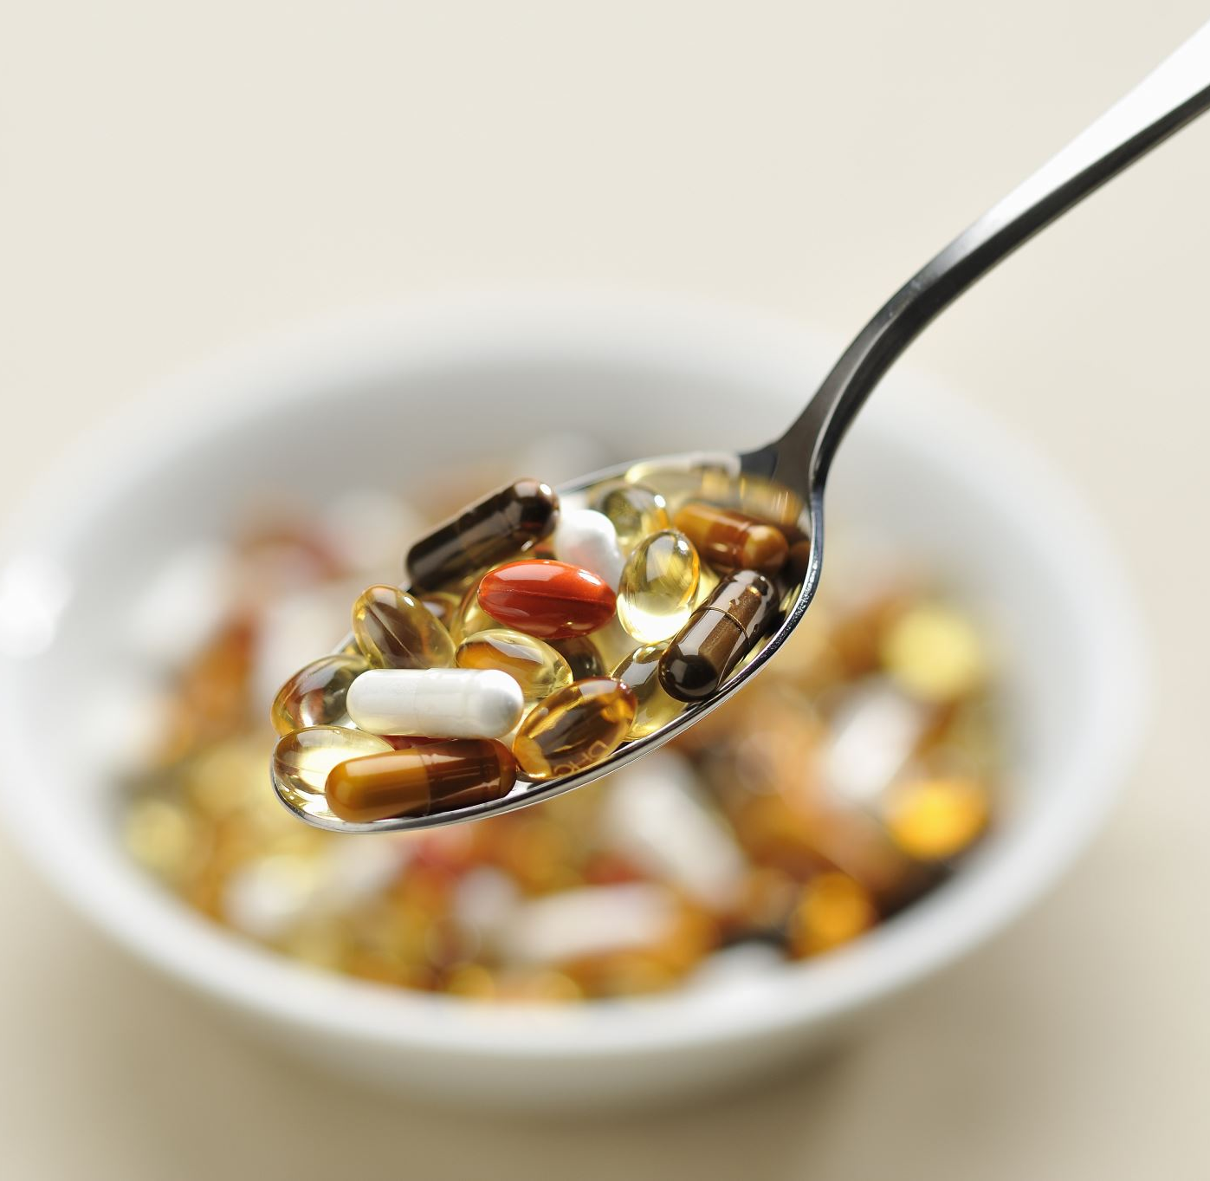
How are you coping?
Substances
Risky/Unhealthy relationships
Distracting
Controlling
Poor eating
Withdrawing
Procrastinating
Oversleeping
Taking stress out on others (lashing out)
Notes:
Most risky adolescent behaviors (including substance use, self-harm, violence, Internet addiction, and a host of other problems) serve at least partly as coping strategies that help youth manage uncomfortable stressors. If we help youth to develop a repertoire of alternative coping strategies, we will diminish their need to turn to maladaptive coping.
So I am hoping by the end of this presentation you will be able to identify the difference between some maladaptive coping strategies, and healthly ones.

Slide 8
Stress reduction plan(Coping skills)
Accurately assess the stressor
Effectively Problem Solve
Maintain a state of health optimal for managing stress
Manage emotions in a healthy way
Use safe, healthy strategies to avoid other problems.
Notes:
A comprehensive stress-reduction plan should include a wide array of strategies this is going to prepare your youth to: Accurately assess the stressor. • Effectively problem-solve. • Maintain a state of health optimal for managing stress. • Manage emotions in a healthy way. • Use safe, healthy strategies to avoid other problems.
A stress-management plan needs to be presented quite differently for different ages both because coping strategies change across the life span and because children’s cognitive capacity to implement a plan varies substantially by developmental stage.
• Children. They should be offered opportunities to learn how to feel emotionally healthy and physically strong. They will learn that they feel better after exercise and happier after they have expressed themselves creatively. Blowing bubbles can teach them about controlled and relaxing breathing.
Mid and late adolescents may have difficulty learning stress reduction techniques from their parents, but may still be responsive to professionals. Additionally, when you do go to create a stress reduction plan with them, make sure they are not already activated because as we just learned, that prefrontal cortex and learning center of the brain is most likely off line if they are operating in a stress based capacity.
Additionally teens should be given opportunities to design their own plans, and I have some resource links at the end of this presentation you can pass along for them to fill out on their own time.
And then most importantly, All children and adolescents will learn from what their parents model. So as an adult, your most valuable tool is showing them how you yourself utilize self care and these skills in your own daily life. Being open about how your feeling in regard to stress, what activities your chosing to engage in is such a wonderful way to not just be a great roll model, but to also foster a deeper trusting relationship.

Slide 9
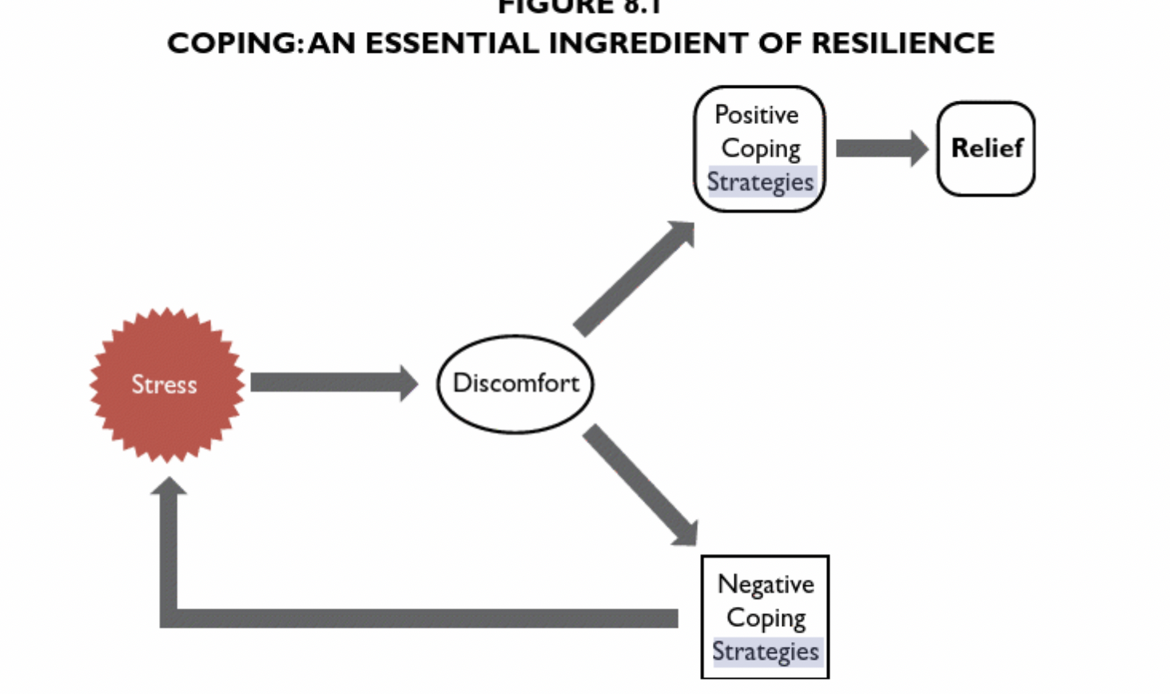
Assessing the Stressor
What is causing the imbalance?
Are we using ‘catastrophic thinking’?
Are we able to see the around the stressful situation?
Notes:
Motivational interviewing link for parents
A first step is to accurately assess the stressor. Do we know what is causing the disruption? Is it more than one thing? Stress is an adaptive tool that transforms our minds and bodies to react to potentially life-threatening emergencies. A small amount of stress such as an upcoming exam or deadline can increases our vigilance and prepare us for tackling that test.But when we get a full dose of stress, to a non threatening situation as we would to a true life or death emergency, it can be maladaptive. When a stressor is experienced out of proportion to its real potential effect, it is known as “catastrophic thinking.” If a person is stuck in a pattern of catastrophic thinking, it can lead to ongoing anxiety and hyperreactivity. The first step of accurately assessing the stressor is determining if it is a real bear, or simply our mind using catastrophic thinking.
Once you have established there isn’t a bear about to eat you, can you determine what is causing your stress to rise?
If you have found the stressor, great! That means you or your teen are ready to ask yourself the next very important question which is, can you look AROUND the stressful situation? Can you remind yourself what your going through is temporary? Can you remind yourself you will naturally find a new level of homeostasis? Can you see ways to solve it or imagine an alternate angle? If your teen is answering yes to these things, than that is a great indication they are ready to continue building this plan. They are in an action stage, and ready to take control of their situation. If not, you are going to want to have them jump into a few health focused coping skills before they build a plan to solve the stress.

Slide 10
Effectively problem solve
Identify and Address the Problem
Avoid Stress When Possible
Letting Some Things Go
Notes:
Point 1: Identify and then address the problem. (This point offers problem-focused engagement strategies.) Action that addresses the problem diminishes the source of stress.
A key to using this strategy is to clarify the problem and then divide it into smaller pieces, committing to work on only one piece at a time. This decreases the sense of being overwhelmed and increases efficacy. Some strategies to implement this include making lists and timelines followed by a plan to address each component of the problem. Specific Measurable Attainable Realistic Timely.
So Metaphorically, this is about helping teens revisualize problems from being mountains too high to be scaled into hills situated on top of each other. As they stand atop each hill, the summit appears more attainable. Strategies like this can really be used to help teens approach larger crises or emotional issues by breaking them into manageable steps.
Point 2: Avoid stress when possible. (This point is a problem-focused strategy that leads to thoughtful disengagement.) This avoidance strategy teaches all young people to consider their triggers to stress and to realize that some of them can be avoided entirely. It teaches that avoiding trouble is an act of strength. For example, knowing and avoiding people, places, and things that set off stress can open the door to healthier ways of coping..
Point 3: Let some things go. (This is another thoughtful, problem-focused, disengagement strategy.) While it can be useful to try to fix some problems, it is also pausible to waste precious energy worrying over things that are unchangeable, taking away from our capacity to fix things that CAN be changed.

Slide 11
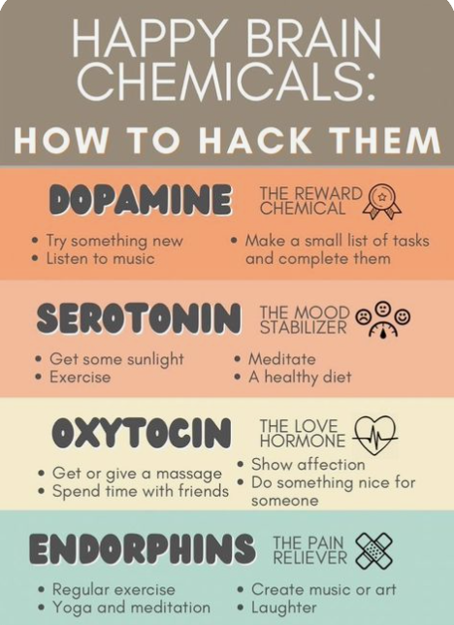
Maintaining your health
Exercise
Active Relaxation
Eat well
Sleep well
Notes:
Alright, point three of creating your stress reduction plan is "". So I know a lot of people don’t like to hear this, but Exercise may be the single most important part of the plan, and it is absolutely the starting point for someone whose stress hormones prevent them from addressing any other problem or having insight into how to address a problem. When a stressed person does not exercise, their body is left feeling as if they haven’t run from the “tiger.” Therefore, the body senses it is still lurking and they remain hypervigilant (nervous), their chronic stress hormones keep their blood pressure raised in preparation for the need to leap at any moment. It is not surprising, therefore, that exercise is so tightly linked to increased health and has been shown to contribute to emotional well-being and to positively affect stress, anxiety, depression, and attentiondeficit/hyperactivity disorder.
We can teach our kids. “When you are stressed, your body is saying, ‘Run!’ So do it.” You may think you don’t have time to exercise when you are most stressed, but that is exactly when you need it the most.” additionally you can remind yourself, “You will be able to think better after you have used up those stress hormones.
Active relaxation. Because the parasympathetic (relaxed) and sympathetic (emergency/stressed) systems do not operate simultaneously, a key to relaxation is to stimulate the parasympathetic system. Deep methodical breathing, therefore, is the portal to relaxation. This is a mainstay of Eastern medicine techniques, yoga, and meditation, and it is even used to gain focus in the martial arts. Young people can be taught “You can flip the switch from being stressed to relaxed if you know how to turn on the relaxed system.”
One technique is 4 to 8 breathing: “Breathe deeply and slowly. Try to take a full breath. First, fill your stomach and then your chest while counting to 4. Hold that breath as long as it feels comfortable, let the breath out while counting to 8. This requires your full concentration. If your mind wanders, as it will, remind yourself to refocus on your counting and breathing. Over time, your mind will be more able to stay focused on how you are feeling now rather than past or future worries.” Mindfulness is a powerful technique that achieves a state of relaxation by living fully in the present while actively reminding you to let go of worries. Hand breathing.
Eat well. Proper nutrition is essential to a healthy body and clear mind Most people know and understand that healthy food is good for your body, but Only some people realize that it also keeps you alert through the day and your mood steady. People who eat mostly junk food have highs and lows in their energy level, which harms their ability to reduce stress. Eating more fruits, vegetables, and whole grains can keep you focused for a longer time and aid in emotional and hormone regulation that is so important for this age group.
Sleep well. Proper sleep is key to stress management. Some people do not sleep well because of poor sleep hygiene, including having too much stimulation in their bedrooms and keeping irregular hours. Another source of lost sleep is stress itself; as many of us use the bed as a place to resolve their problems. The basics of sleep hygiene include going to bed around the same time every night, and limiting exposure to blue light for an hour before bed time (computers and cell phones). But a list of suggestions that also contribute to healthy sleep hygene includes exercise 4-6 hours before bedtime, taking a hot shower one hour before bed, About half of an hour before bed, go somewhere other than your bed and do ­ something to set your worries aside, journaling, meditating (do this in dim light). If you are the kind of person who thinks about all the stuff you have to do tomorrow, make a list before you go to bed and set it aside. If you wake up in the middle of the night thinking, move to another spot to do your worrying. You’ll get tired soon, then go back to bed.”
If you have trouble falling asleep, try 4 to 8 meditative breathing, box breathing, or muscle tension exercise.

Slide 12
Managing emotions in a healthy way
Take instant vacations
Creative Expression
Release emotional tension
Journaling
Notes:
Point 8: Take instant vacations. (This point offers healthy disengagement strategies.) Sometimes the best way to de-stress is to take your mind away to a more relaxing place. Young people can be taught to take advantage of their imagination and ability to focus on other interests. Young people can be reminded to take breaks from stress by using Visualization: “Have a favorite place where you can imagine yourself relaxing. Enjoing your interests or hobby: Get into whatever you enjoy doing that is fun and creative. (This might include playing an instrument, drawing or writing— activities that focus and use a more creative part of a young person’s brain.)
Change your venue: take a walk outside. “Read a good book, even one you have read before.” (It may be that reading is the best diversion because it uses all of the senses— one has to imagine the sounds, sights, and smells and one also feels the emotions; there is little room left for your own worries. You are on a real vacation.)
Music: “Listening to music can be a great break from stress and it can sort of “reset” your emotions.”
Release emotional tension. A person needs to be able to express emotions rather than letting them build inside. The ideas in this category include connecting to others and letting go of feelings with verbal, written, nonverbal, and creative expression. There are a wide variety of options available to meet someone’s temperament and talents. Talking to someone who is worthy of your trust: Talking to a good friend, parent, teacher, or a professional, like a doctor, nurse, or counselor, can really help you get worries off your mind. Find an adult who will listen and whom you can ask for advice.
Creativity: Things like art, music, poetry, singing, dance, and rap are powerful ways to let your feelings out.
Journaling: encourage your teen to “Write it out!”

Slide 13
Health Realization
We are the creators of our own thoughts
The quality of our thinking (positive, negative, neutral) creates our perception of reality in the moment.
Negative thoughts trigger our stress response, which distorts our perceptions and yields unreliable and often inaccurate information.
Notes:
Engaging in all of these coping methods, both for solution focused and long term stress care are so important, but I also want to remind you that in addition to all those coping protocols, the foundation of shutting down this system is letting go of negative thoughts and releasing stress based thinking! Now, engaging in those skills we have discussed is going to allow you to do this, if you are triggered -
We can train ourselves to get into the habit of noticing our own negative thoughts, disengaging from them, and thus shifting to a higher state of functioning all together. Health realization reminds us that:

Slide 14
Embracing Stress
Notes:
So, ive just gotten done telling you how bad stress is for your body, and a bunch of other coping strategies that help you alleviate it. But the one I actually love the most is actually the most simple. Which is simply embracing the stress.
How can one cultivate a mindset to embrace stress?
The initial research on stress mindsets, which was conducted by Stanford psychology Professor Alia Crum, showed that viewing stress as a helpful part of life, rather than as harmful, is associated with better health, emotional well-being and productivity at work – even during periods of high stress.
One reason that how you think about stress matters is because it changes how you respond to stress. Viewing stress as harmful leads us to this frantic state in which we turn to the closest coping we can find, and often times, those are pretty maladaptive. One study found that simply having the goal to avoid stress increased the long-term risk of outcomes like depression, divorce and getting fired, by increasing people’s reliance on harmful coping strategies.
In contrast, viewing stress more positively seems to encourage people to cope in ways that help them thrive, utilizing all the methods we have just gotten done discussing.

Slide 15
Protective stress beliefs
View your stress as helpful, not debilitating.
View yourself as able to handle and grow from the stress in your life.
View stress as something that everyone deals with, not something that is unique.
Notes:
The three most protective beliefs about stress are: 1) to view your body’s stress response as helpful, not debilitating – for example, to view stress as energy you can use; 2) to view yourself as able to handle, and even learn and grow from, the stress in your life; and 3) to view stress as something that everyone deals with, and not something that proves how uniquely screwed up you or your life is.
The emerging science on stress mindsets shows that it is possible to change all of these attitudes, even if we are used to thinking of stress as harmful. For example, when you feel your heart pounding from anxiety, you think about how your body is trying to give you the energy you need to rise to the challenge. More importantly, changing any one of these attitudes can help you thrive in the face of ordinary stress as well as chronic or even traumatic stress.

Slide 16
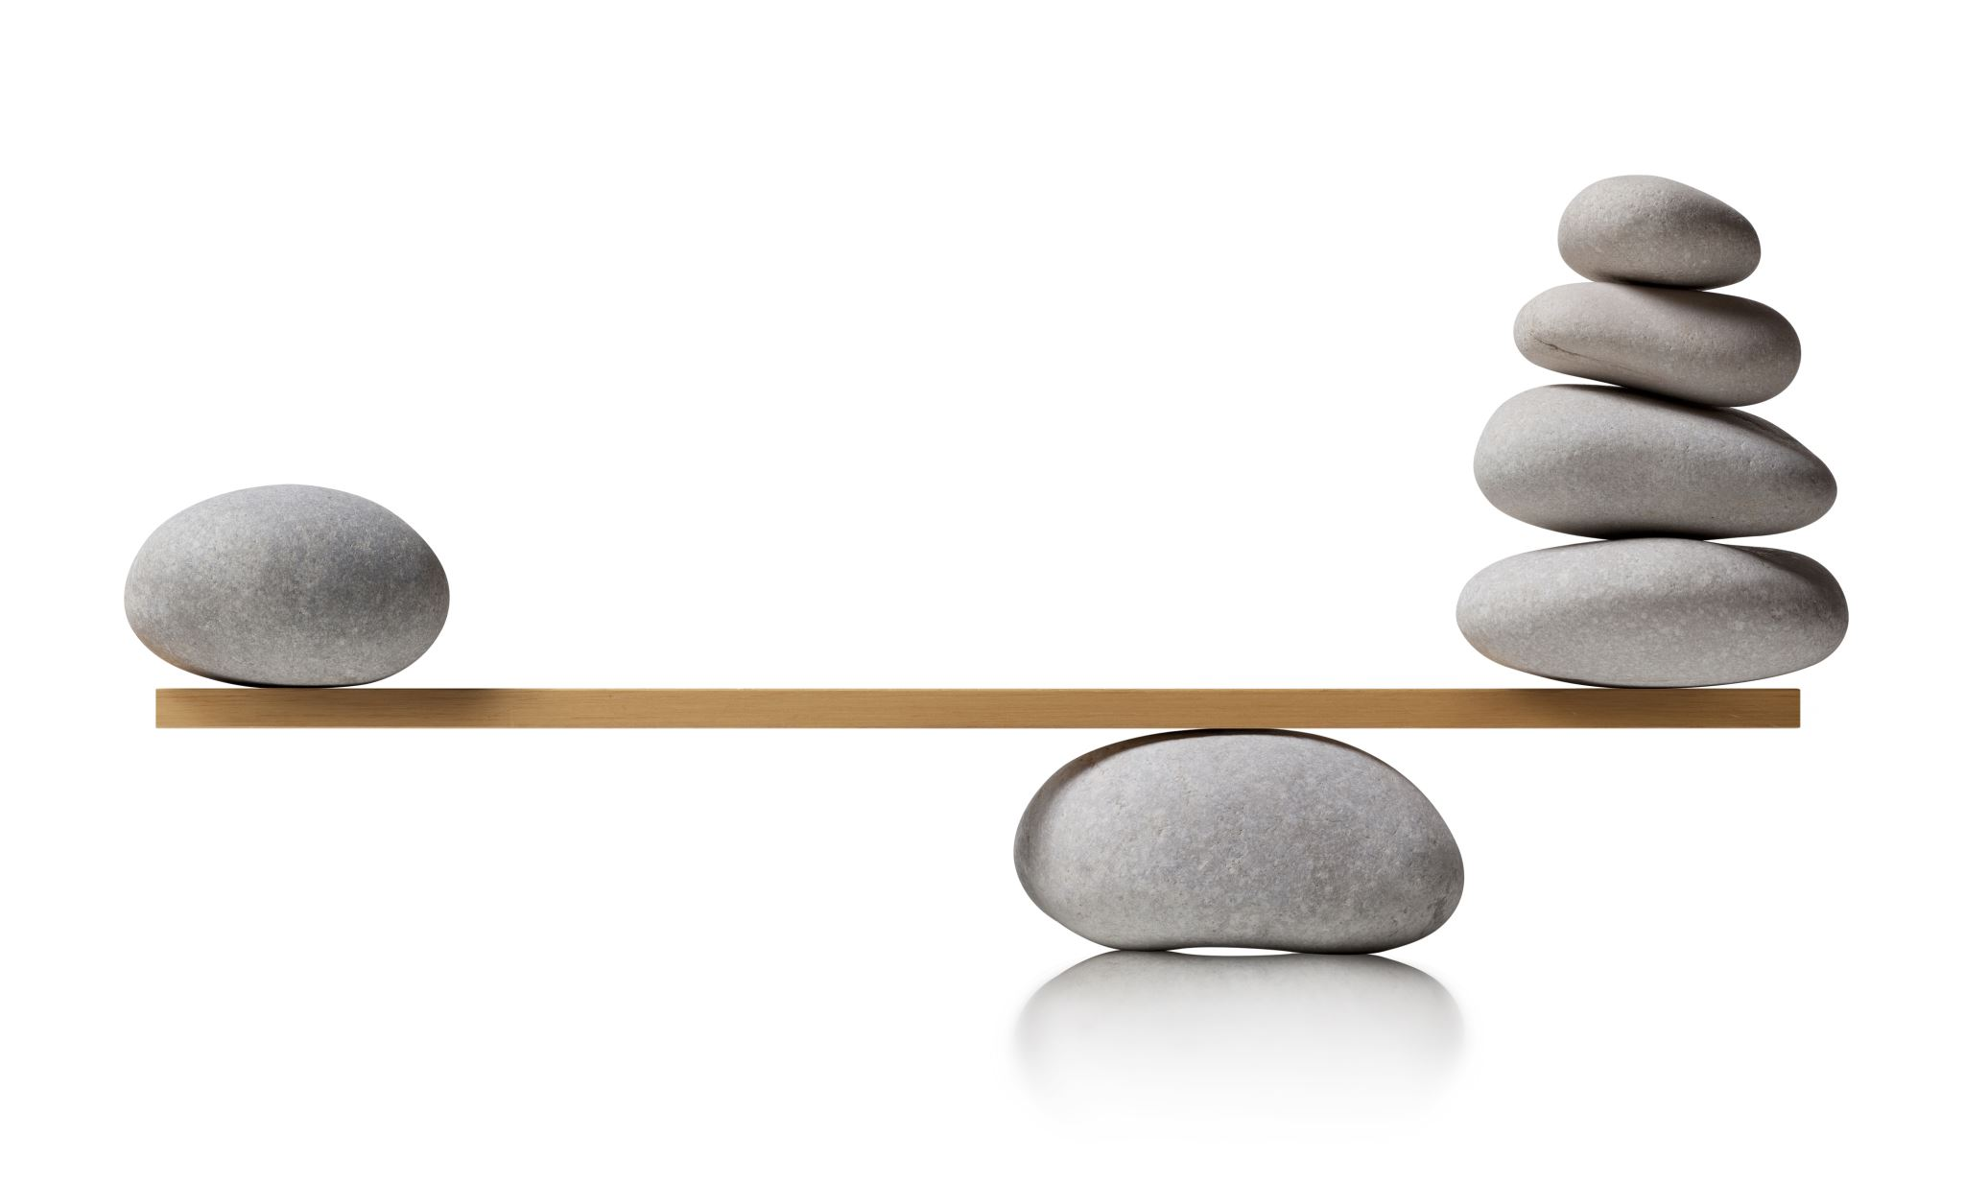
Balance your mindset
Notes:
Now, Choosing to see the upside of stress isn’t about denying the fact that stress can be harmful. It’s about trying to balance your mindset so that you feel less overwhelmed and hopeless about the fact that your life is stressful. We rarely get to choose the stress in our lives, and it isn’t realistic to think we can avoid stress. Given that life is going to be stressful, what do you gain by focusing on the fear that the reality of your life is sort of beating you up?
The ability to embrace stress requires a high tolerance for ambiguity and uncertainty. You have to be able to understand that two seemingly opposite things can be true at the same time. It can be true that going through something stressful can make you sick or depressed, and it can also be true that the same stressful experience can ultimately make you stronger, more compassionate and more resilient over time.

Slide 17
Practice gratitude
Gratitude Journal
Get perspective
Contribute
Be part of a team
Notes:
The practice of gratitude, in and of its self has been linked in studies to decreased levels of stress and increased levels of acceptance and joy. When we focus on what we are thankful for we are much more likely to be content and reside within our window of tolerance. Encouraging your teen, and even yourself to begin a journal, writing just one things you are greatful for a day seems small, but can really make a big difference.
Hand in hand with gratitude is contributing to something bigger. Children and adolescents who consider how to serve their family, community, school, and nation will feel good about themselves, creating a larger sense of purpose, and benefit from making a difference in other people’s lives. First, they will learn that it feels good to serve, and that may reduce their sense of shame or stigma when they need to reach out for help themselves. Finally, people who serve others may be better able to put their own problems in perspective. Especially at this young age, it is easy to focus and stress over small details of life.

Slide 18
Find Meaning
Notes:
Stress is most likely to be harmful when the following conditions are present: it feels against your will, out of your control and utterly devoid of meaning. If you can change any of these conditions – by finding some meaning in it – you can reduce the harmful effects of stress.
The relationship between stress and meaning can be very helpful to understand. A 2013 study asked a broad national sample of adults in the U.S to rate how much they agreed with the statement, Taking all things together, I feel my life is meaningful. The researchers then looked at what distinguished people who strongly agreed with the statement from those who did not. Surprisingly, every measure of stress that the researchers asked about predicted a greater sense of meaning in life. People who had experienced the highest number of stressful life events in the past were most likely to consider their lives meaningful. People who said they were under a lot of stress right now also rated their lives as more meaningful. Even time spent worrying about the future was associated with meaning.
We cannot take away stress. We can, however, acknowledge that stress often represents a young person’s attempt to deal with uncomfortable feelings and situations. Most importantly, we can make sure that our kids possess a wide repertoire of positive coping strategies.
And remember - rather than being a sign that something is wrong with your life, feeling stressed can be a barometer for how engaged you are in activities and relationships that are personally meaningful.

